Slide 1
COSC 4353/6353 Software Design Fuel Project

Slide 2


Overall Web Application Topology
Browser
Web Server
Database Server
Django
static
files
DOM
Parse
Request
Sqlite
Parse
Response
Views
django
code
HTTP
SQL

Slide 3
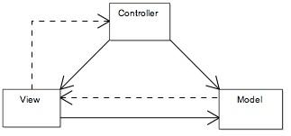
Design Pattern: Model-View-Controller
the model represents the information (the data) of the application and the business rules used to manipulate the data;
the view corresponds to elements of the user interface such as text, fields etc.
the controller manages details involving the communication to the model of user actions.

Slide 4

Django Framework
Browser
WGSIConfig
settings.py
D
O
M
Django
Click
Routing
urls.py
views.py
Parse
Response
Views
Templates
forms.py
Database
Javascript
Shell
Models
models.py
/admin
admin.py
Notes:
We call the Data bit - the “Model” or Data Model
We call the “making the next HTML” bit the “View” or “Presentation Layer”
We call the handling of input and the general orchestration of it all the “Controller”

